Slide 1
Cloth Amortization
Timothy Luciani Mitchell Luban

Slide 2
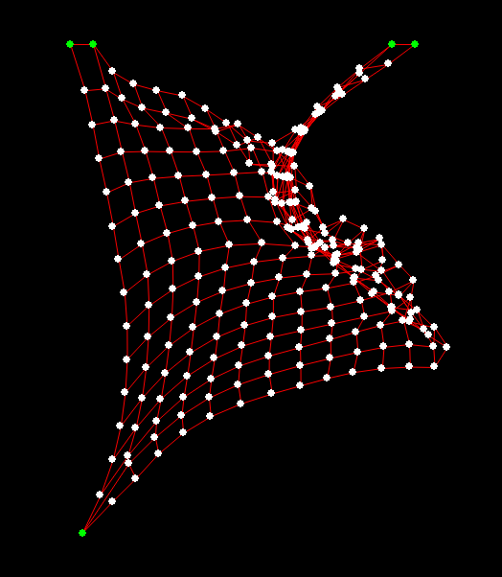
outline
Description and Design
Goals
Implementation
Results and Setbacks
Future Work

Slide 3
outline
Description and Design
Goals
Implementation
Results and Setbacks
Future Work

Slide 4

Description and design
Cloth Simulation:
Trivial (ish)
Doable
Somewhat inexpensive
So why…?

Slide 5
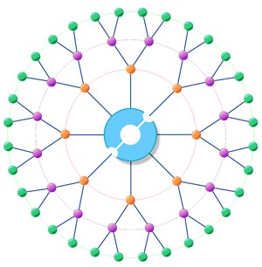
Description and design CONT.
Simplicity for one user can open many doors
Easy to parallelize
Not Impossible to Amortize
Since the same simulation will be viewed on many machines
Every machine do the same computation?!

Slide 6
outline
Description and Design
Goals
Implementation
Results and Setbacks
Future Work

Slide 7
GOALS

Slide 8
outline
Description and Design
Goals
Implementation
Results and Setbacks
Future Work

Slide 9
IMPLEMENTATION

Slide 10
outline
Description and Design
Goals
Implementation
Results and Setbacks
Future Work

Slide 11
RESULTS AND FEEDBACK
Initially, the CPU proved Faster than the GPU
Due to the overhead of Cuda

Slide 12
outline
Description and Design
Goals
Implementation
Results and Setbacks
Future Work

Slide 13
FUTURE WORK

Slide 14
Words to the weary
Don’t use Boost unless you absolutely have to!!

